Slide 1
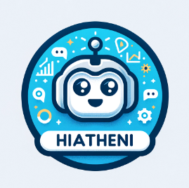
InnovateGPT Group Problem Statement
Hi Atheni

Slide 2
What is “Hi Athenie”?
Hi Atheni is an advanced AI-powered solution designed to transform sustainability reporting analysis.
It uses Azure OpenAI and Azure AI Search for efficient document retrieval while ensuring sensitive information remains secure within internal storage, addressing concerns over using external AI services like ChatGPT.

Slide 3
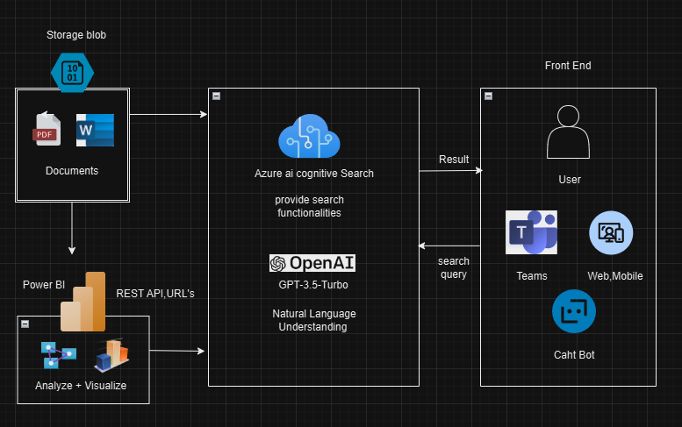
Solution Architect

Slide 4
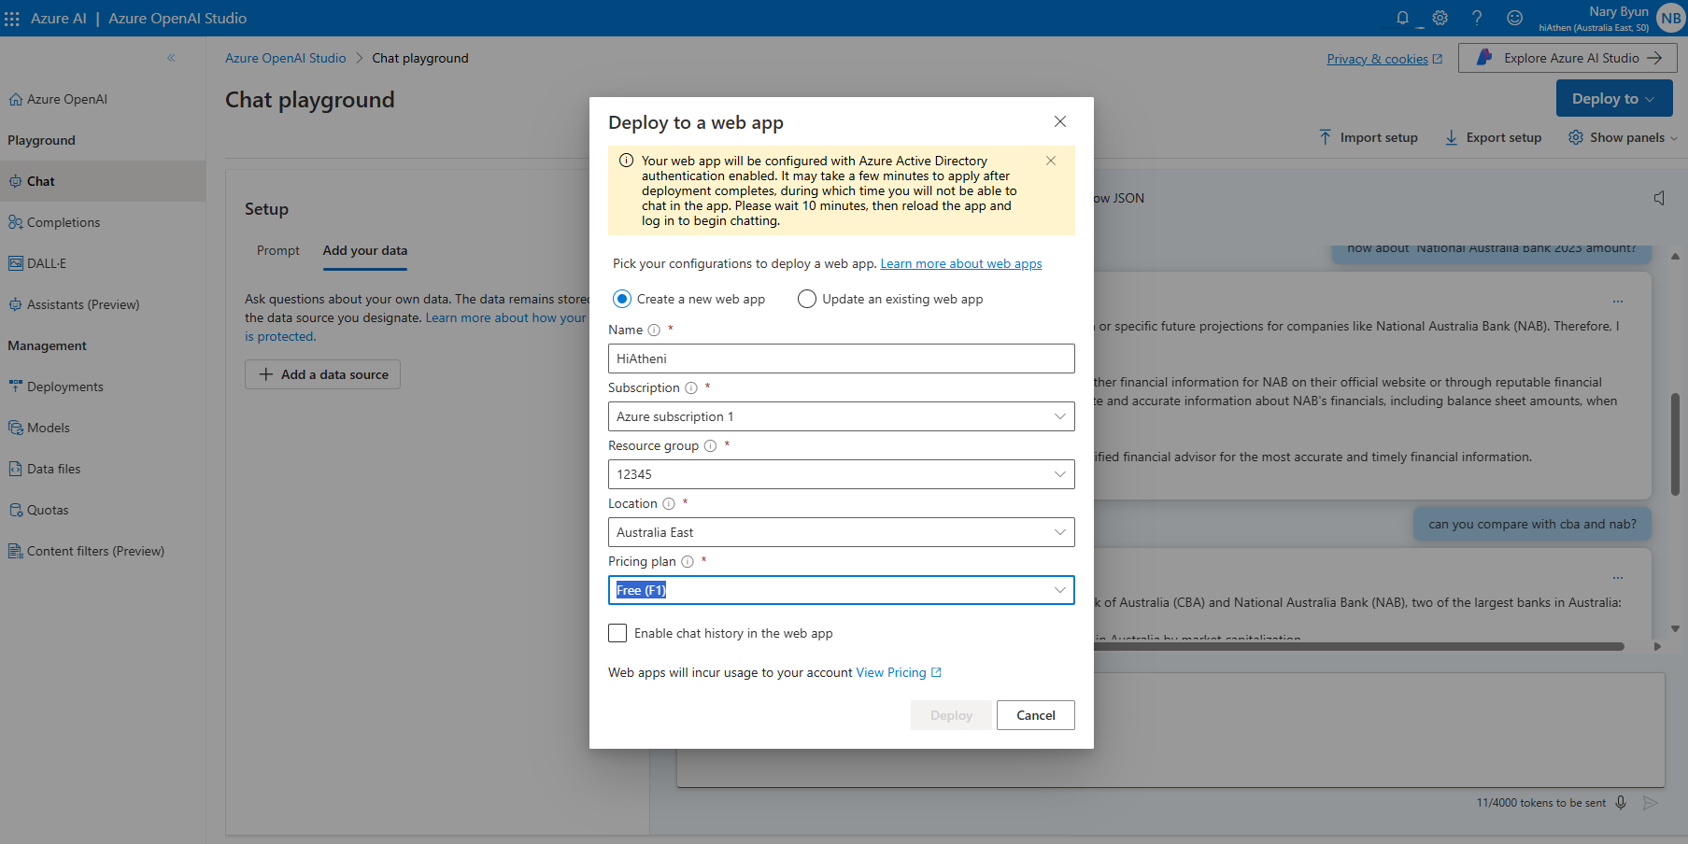

Slide 5
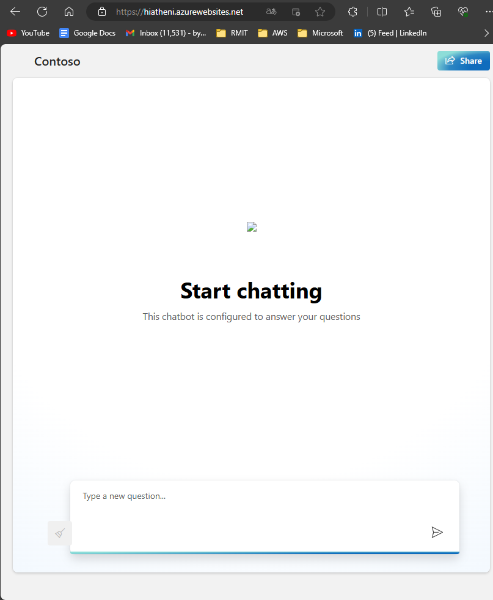

Slide 6
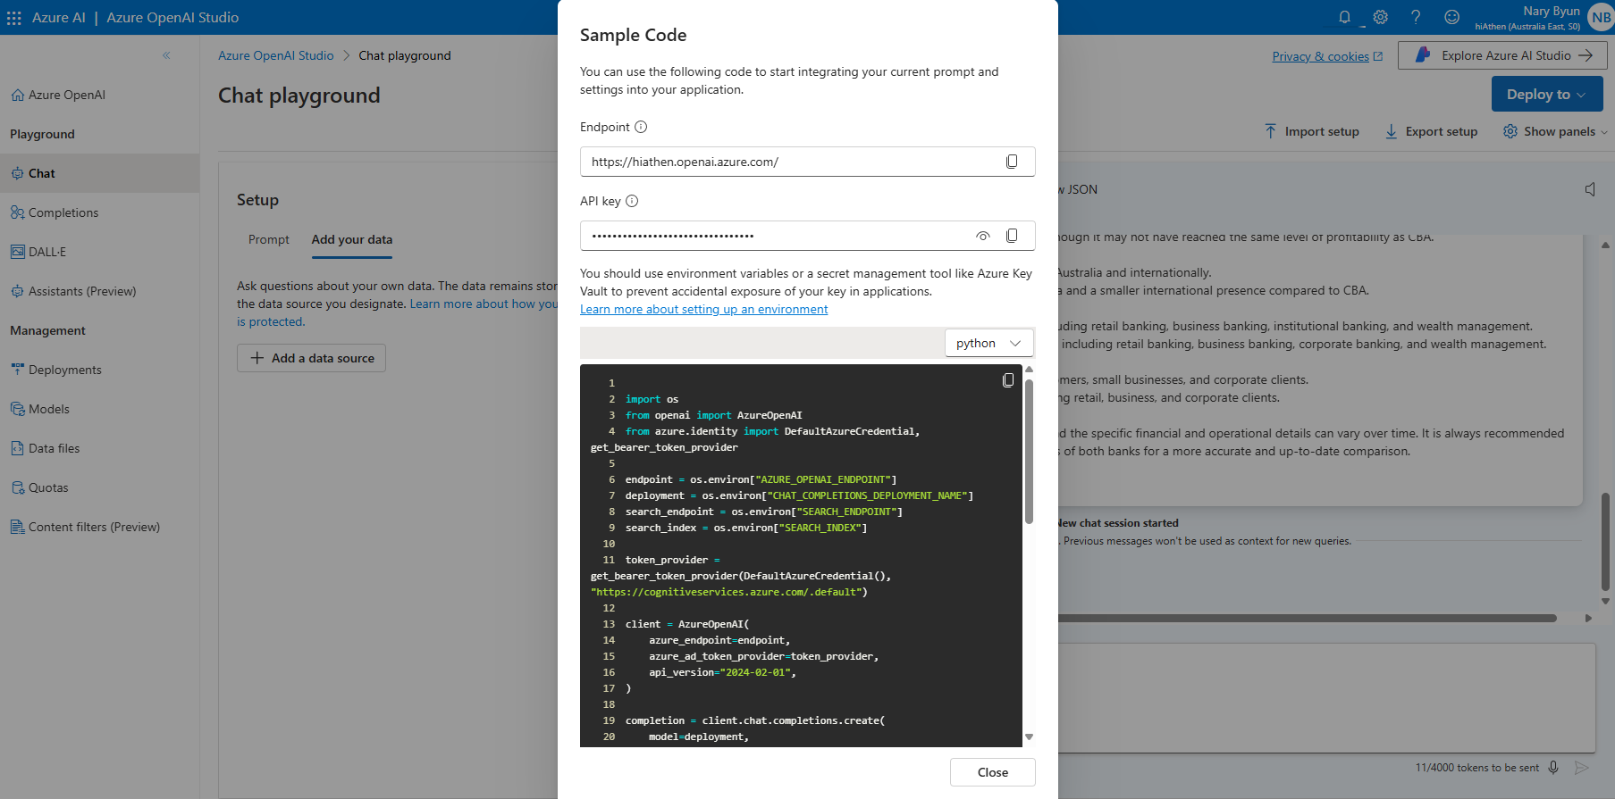

Slide 7
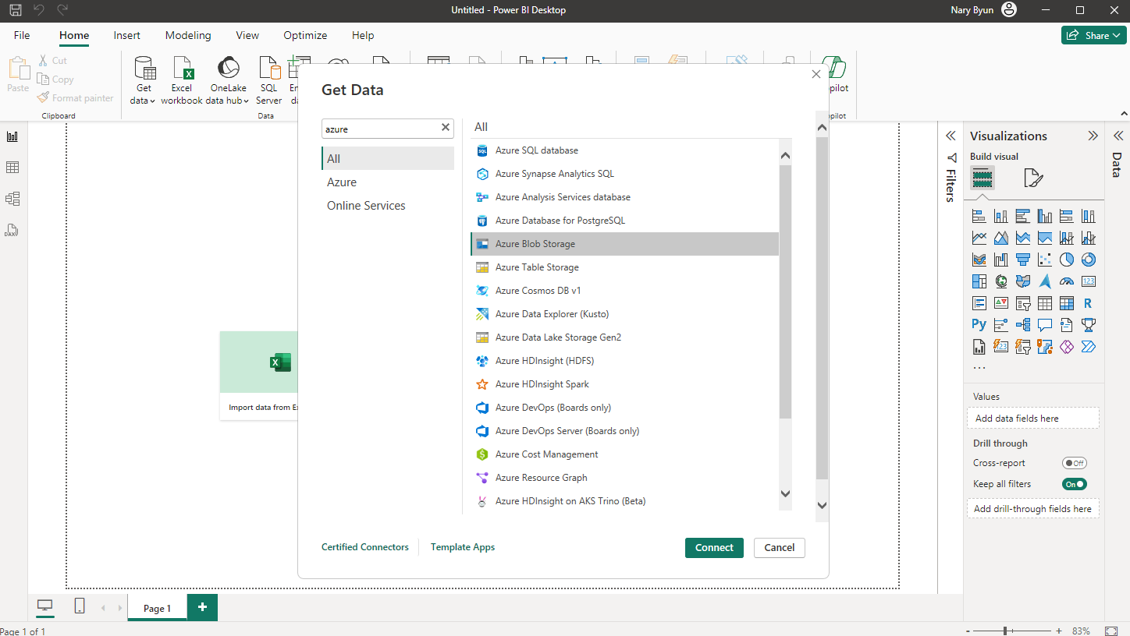

Slide 8
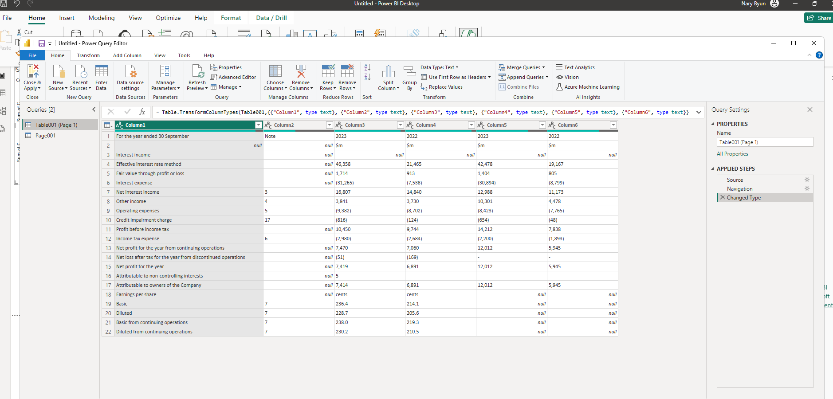

Slide 9
Future Scopes
Currently, Hi Atheni is in the prototype phase.
Future developments include:
More Advanced NLP Models: To improve the accuracy and depth of text analysis.
Teams App and Chat Integration: Using Power Apps tools to integrate with the Teams app on company accounts to automatically update data and provide ease of use.
Enhanced Visualisation Tools: Adding more sophisticated visualisation tools to provide deeper insights.
AI-Powered Recommendations: Offering personalised recommendations based on the analysis to improve sustainability practices.

